Slide 1


SHEEB
The sole habit tracker for you, habit slacker.

Slide 2

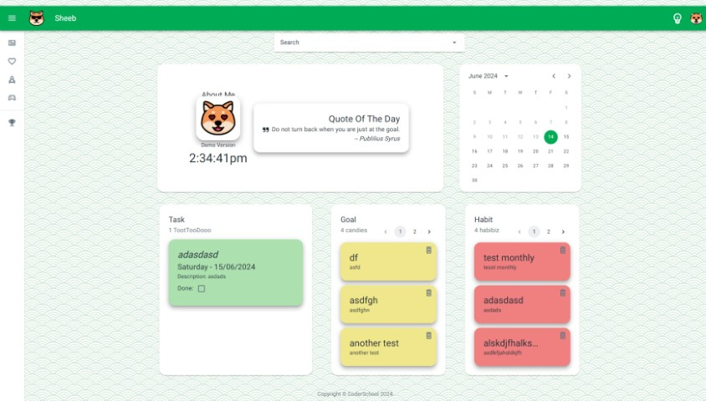
Login Page:
- Click the bulb to trigger darkmode
DashBoard:
Consist of
About me,
Calendar to pick date and fetch information
Task List, Goal List, Habit List

Slide 3
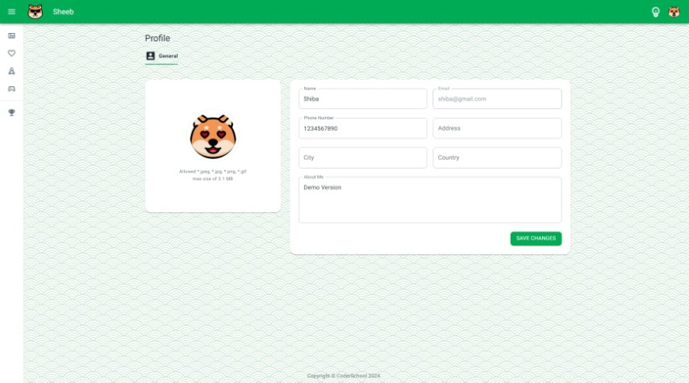

Profile Page:
Avatar
Name
Email
Phone Number
Address
City
Country
About Me
All fields are validated with Yup schema through React – hook – form.
Avatar image uploads to Cloudinary host service.

Slide 4
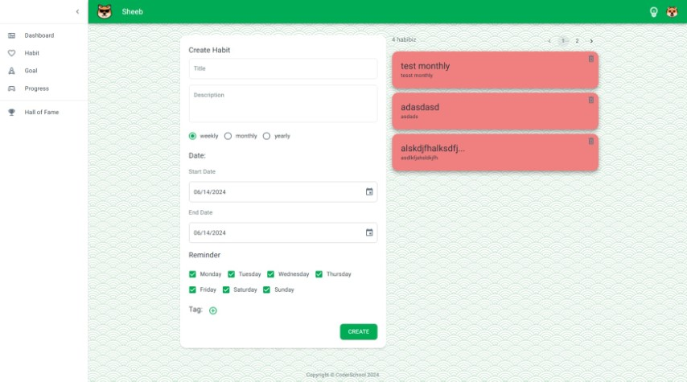

Habit Page:
Form
Title
Description
Counter: “Weekly”, “Monthly”, “Yearly”
Tag list
- Habit List
Single Card
Name and Description
“Weekly” : render startDate and endDate, with checkbox for reminder of particular day.
“Monthly” and “Yearly” options would act like setting up monthly meeting or birthday.

Slide 5
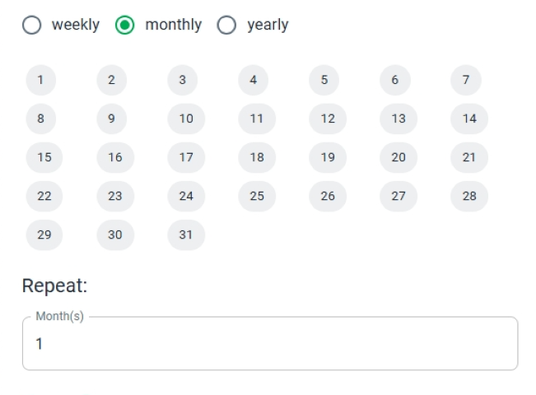
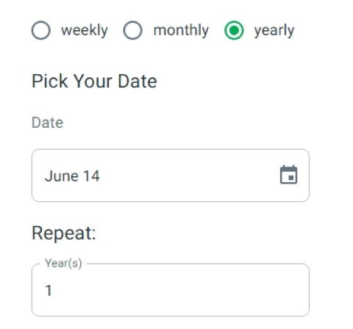
Counter Render:
Monthly
Yearly
- Monthly
31 days in Month
Repeat for X months starting from current month.
- Yearly
Single date month in year
Repeat for X years starting from current year.
“Weekly” : render startDate and endDate, with checkbox for reminder of particular day.
“Monthly” and “Yearly” options would act like setting up monthly meeting or birthday.

Slide 6
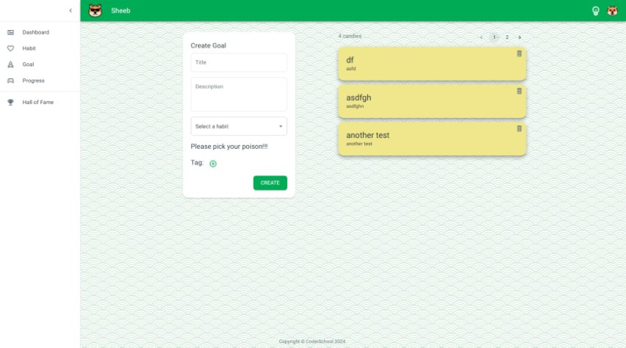
Goal Page:
Form
Title
Description
Habit Dropdown list
Tag list
- Goal List
Single Card
Name and Description
Habit Dropdown list will fetch available Habits
Based on the counter field in selected Habit. will determine the Goal percentage and achievement render.

Slide 7
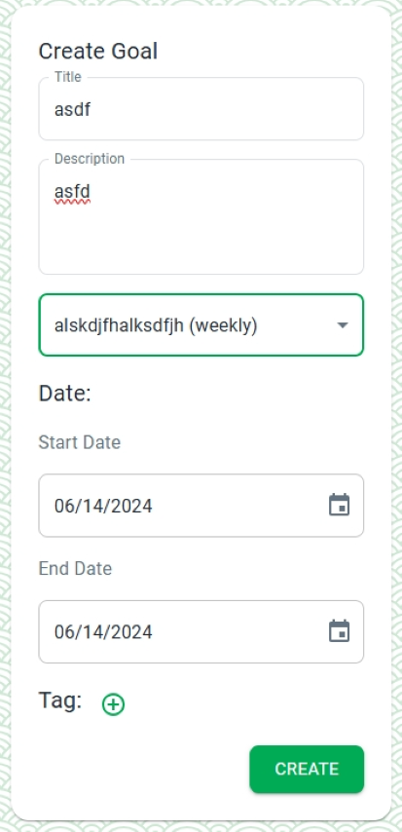
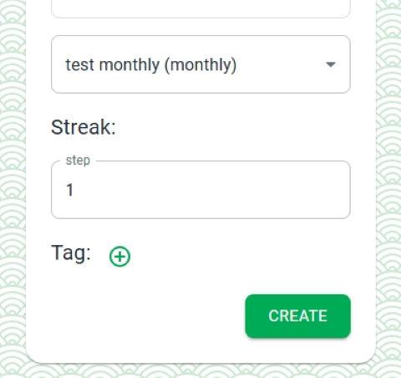
Goal Counter Render:
Weekly
Monthly/ Yearly
Weekly Habit will render Goal form with startDate and endDate to determine the streak
Monthly and Yearly Habit will render Goal form with repeat streak.

Slide 8
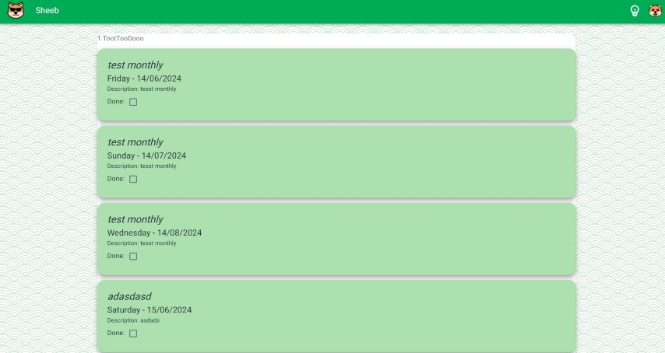
Progress Page:
List of Single card
This page will display all Progresses that User has committed his entire life mission to fulfill.

Slide 9
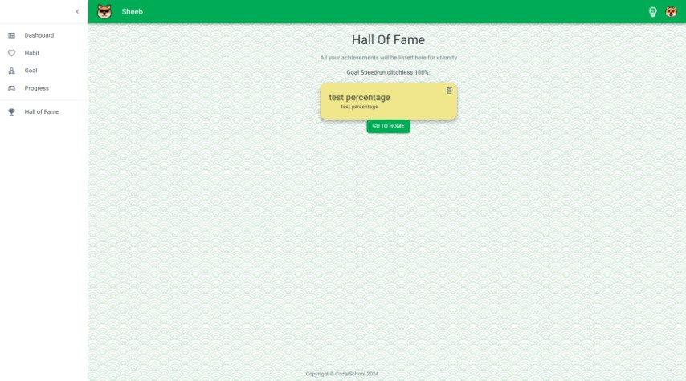
Hall of Fame Page:
List of 100% completion Goal
“A picture is worth a thousand words.” --

Slide 10
Thank You For Your Anticipation
Hoàng Viết Thanh – Full Stack Web App Dev Wanna-be

